Slide 1
DAA PROJECT CT-3
PRIMS ALGORITHM

Slide 2
INTRODUCTION
The problem deliberated is that of networking a given set of network nodes with shortest possible cables of direct links. Simple practical procedures have been given for solving this problem.
The techniques given are based on prims algorithms.

Slide 3
PROBLEM STATEMENT
Problem statement – Given a set of University buildings, connect them by a fiber network cables of direct terminal-to terminal links having the smallest possible total length (total sum of cable lengths). A set of buildings are connected, if and only if there is an unbroken chain of fiber links between every two buildings in the set. The purpose of the study was to investigate the effectiveness of PRIMs algorithm in the design of University LAN networks and to establish the effect of prims algorithm in the design of a Campus Network at SRM University.

Slide 4
EXPLANATION OF THE SITUATION
The problem considered is that of planning a large-scale Campus network based on fiber technology. Such networks are expensive to install but are very reliable. Optic fiber network offers fast and reliable network that provides high end internet services.
Therefore for a fast growing institution of higher learning, these services are essential hence the need for a reliable data networks in University campuses. This can be realized by installation of optic fiber network.
Optic fiber networks use light for data transmission. According to ,Optic Fiber is the most important type of media that uses light for data transmission. Data is transmitted in form of light pulses emitting from a light emitting diode travels through glass filaments and are received on the other end by a photosensitive device.
Installation of such network in a fast growing institution would therefore improve on the quality and efficiency of data communication.

Slide 5
…CONTINUED
Installation of fiber network is an expensive affair and proper planning is required to realize a fully functional network.
Given a set of University buildings, we propose a model based on Prims algorithm that would enable connection of all buildings to optic fiber network at a minimal cost.
A set of buildings will be considered connected if and only if there is an unbroken chain of optic fiber links between every two buildings in the set. A loop is not allowed and a redundant cable is not allowed either as this will increase the cost.

Slide 6
ALGORITHM
The purpose of the PROJECT is to investigate the effectiveness of Prims Algorithm in the design of Campus Networks. The study demonstrates that the overall costs incurred during the interconnection of University buildings to the existing Local Area Network can be minimized

Slide 7
PRIMS ALGORITHM
An algorithm can be viewed as tool for solving well-specified computational problem. The problem at hand is that of establishing the shortest distance between all the University buildings. Prims algorithm has an application in finding the minimum length, commonly referred to as the cost of spanning tree.
Prims algorithm is a greedy algorithm that obtains the minimum spanning tree by use of sets. It processes the edges in the graph randomly by building up disjoint sets.
The problem at hand was modeled using a connected undirected graph G= (V,E) where V is the set of University buildings , and E is the set of possible interconnections between pairs of buildings and for each edge (u , v) ϵ E, we have a weight (u , v) specifying the length of the amount of optic fiber cables needed

Slide 8
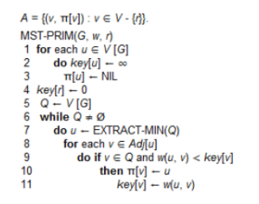
Algorithm
The algorithm implicitly maintains the set A from GENERIC-MST as
A = {(v,v.π): v ϵ V- {r}-Q}. when the algorithm terminates, the priority Q will thus be empty.
The minimum spanning tree A for G is thus A = {(v,v.π): v ϵ V- {r}}. According to , MST-PRIM(G,w,r) can be illustrated as follows:

Slide 9
implementation
SRM University consists of the various key buildings as illustrated in the map below. To implement the algorithm, we consider all the buildings that require an optic fiber connection. A building would qualify to be connected to a fiber network, if it requires a high speed internet connection and can be qualified for point to point communication. The building under consideration is as follows: [SRMIST , Library, MBA,SRM HOSPITAL,MAIN BLOCK , Hostels , TECHPARK, TP GANESAN,UNI ARCH , Hitch , PARK

Slide 10
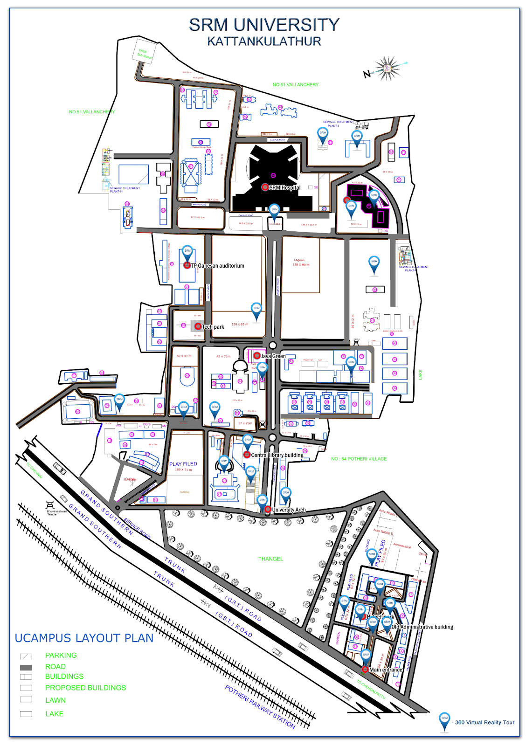
MAP OF THE UNIVERSITY.
TOP VIEW

Slide 11
Present situation
Key [1: SRMIST, 2: Library, 3: MBA, 4:SRM HOSPITAL, 5: MAIN BLOCK, 6: GIRLS Hostel, 7: TECH PARK, 8: TP GANESAN, 9: UNI ARCH, 10:Hi TECH PARK] .
The above image shows a topological view of Chuka University with main buildings visible. The study used-scaled sketches to prove that prim's algorithms could reduce the overall cost of fiber installation.

Slide 12
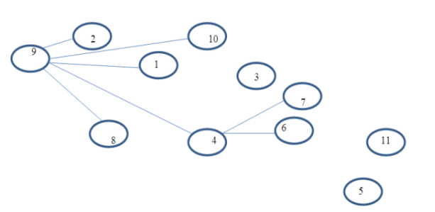
The problem right now
The figure above show the existing fiber network at SRM University, the direct cable links leads to wastage of fiber cable used. With use of Prims algorithm, the overall length of the cable used would be greatly minimized.

Slide 13
Application of prims algorithm
In order to minimize cost, the relative distance of each building installation from the ICT center was measured.
The distance from each building to its adjacent building was also measured. The starting point was ICT center since it forms the root node or the starting point to the entire network. The results of the measurement are summarized in the table below.

Slide 14
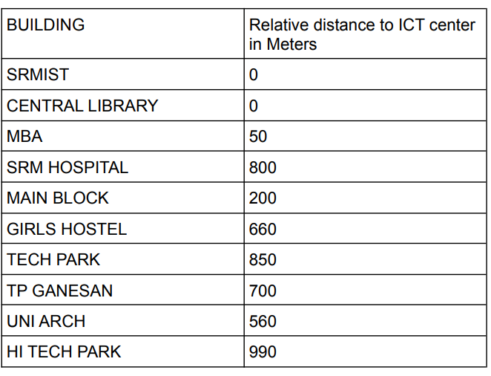
Relative distance to the ict centre
We will use this table for PRIMS ALGORITHM

Slide 15
SOLUTION
By applying the Prims algorithm, proceed as follows to establish the shortest link. Let the ICT center forms the root node, then proceed to the nearest building, which is library and science tuition block
. Their edges have the minimum weight, therefore added to the queue. Library and the science building becomes our new root. From here we extend towards toward other buildings, always using the shortest link.
This continues till we reach all the buildings in the set without forming a loop. When algorithm completes, the entire length of the required cable will be reduced, saving on the entire cost of connecting all the buildings. The figure below shows the outcome after application of prims algorithm to redesign the existing LAN.

Slide 16
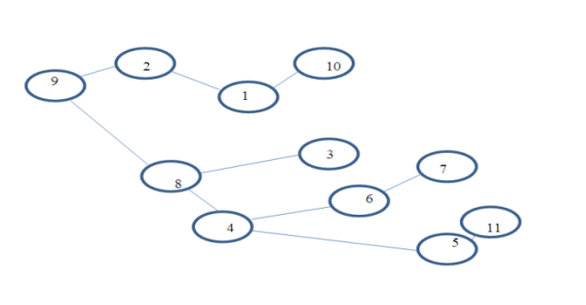
STRUCTURE
We use PRIMS ALGORITHM to make this structure.

Slide 17
conclusion
The application of Prim’s algorithm proves to be effective in establishing the above LAN. VI.
CONCLUSION: Applications of Prims algorithm can be valuable and useful tool in the design of large LAN networks. This is because of its greed nature since at each step it adds to the tree the shortest edge that will contribute the minimum weight of the tree formed.
The algorithm would cater for the existing and emerging buildings. The cost of such is highly reduced as the algorithm always results in the minimum overall distance. The savings on cost could be used to expand the network to other buildings and installation.
This would enable the connections to several buildings enabling more people to be connected to the internet. Though the study was carried out on the existing LAN at SRM University, its findings can be applied to any other network setup that uses optic fibre to minimize on the installation cost

Slide 18
Thank you
Team:-
Manavjeet singh rathore(RA2011042010106)
ABHISHEK JHA(RA2011042010078)
MAYANK (RA2011042010094)

